Slide 1







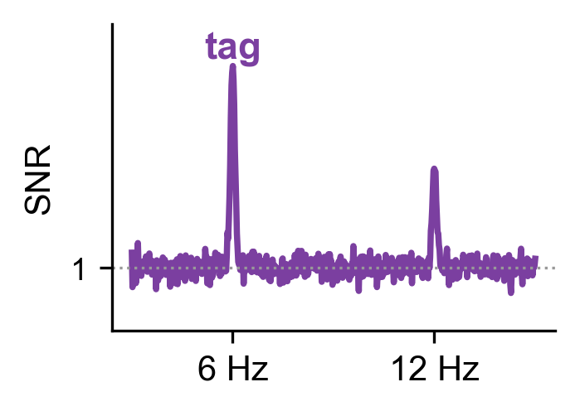
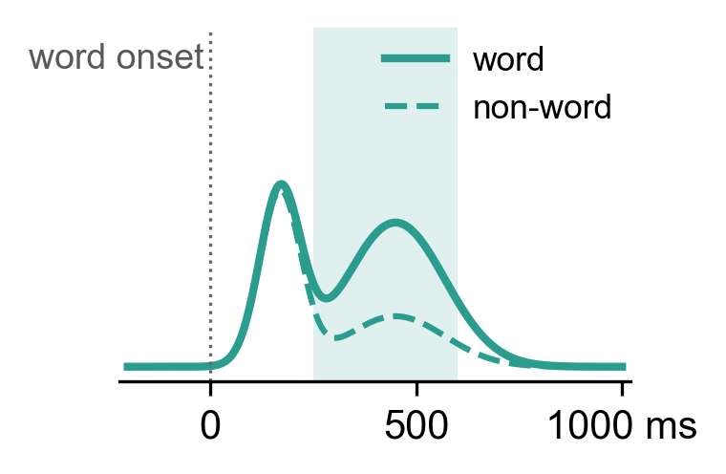

Characterizing word processing pathway using frequency tagging​
SNL 2026 · Geneva
Poster F52 · Session F · Fri 2 Oct, 2:45–4:45 pm
Kishen Senziani¹, Berk Gercek¹, Nina Kazanina¹; ¹University of Geneva, Faculty of Medicine, Department of Basic Neurosciences
A 6 / 7.06 Hz flicker tag tracks the visual input, not wordness; the word-locked response (250–600 ms) separates words from consonant strings, and in anterior temporal cortex the difference is sustained across words.
Update vs. submitted abstract: with fixation baselines and equal trial counts, the tag shows no word-specific effect and the source effect is Word > Non-word.
Background
Results
Visual Word Processing ^{1,2,3,4}
Why frequency tagging? ^{5,6,7,8,9}
1 · Sensor space: the word-locked response separates words from consonant strings (Aim 1)
WORD
3. The Test
Vision
(~100 ms)
Letters/Words (~150-225 ms)
Meaning (~250-600 ms)
1. The Stimulus
2. The Response
Contrast flicker at a fixed rate
(6.00 or 7.06 Hz).
Visual cortex follows the flicker: steady-state visual evoked field (SSVEF)
Can the tag response map the visual word-processing pathway?
Visual area (V1) detects low level features.
Left ventral regions (vOT/VWFA) identify letter strings.
Left Temporal network extracts meaning.
One Word > Non-word cluster over left posterior and temporal sensors (N = 26, 84 sensors, p < .001), robust to blinks, saccades and artifacts (clean epochs: dz = 1.31, 20/21 subjects). Tag × Wordness: n.s.
(a) mean |t| in the cluster window (N = 26); (b) GFP of W − NW vs sign-flip noise (shaded: 95 %; dashed: FWER), exceeded at 628–764 ms; right: grand averages (N = 25) at 350 / 500 ms, ±25 ms; fixation baseline.
AIM 1
Do MEG sensors and sources recover the V1 → vOT → temporal sequence of the literature?
AIM 2
Does the tag response (SSVEF) differ between words and consonant strings?
2 · Sources: Word > Non-word, maximal and sustained in anterior temporal cortex (Aim 1)
Ventral stream: no whole-epoch effect after FDR (FFC / VWFA dz = .34 / .45).
Temporal cortex: Word > Non-word in all 6 ROIs, maximal anteriorly (slope t(21) = 4.81, p < .001).
Anterior part sustained: present before word onset (consistent with a block-level state).
(a) log(Word / Non-word) over the word epoch, 95 % CI, * p_FDR < .05; (b) same effect (dz), fsaverage (V1 medial). N = 22, dSPM, equal counts, fixation baseline. Leakage, late vOT effect: QR.
Methods
1 STIMULUS
2 TIMING
3 TASK
4 PARTICIPANTS
one tag per mini-block
240 Hz frame-locked, 2 blocks
behavioral catch-query
MEG 306 ch. 2 kHz + eye tracker
Structural T1 MRI
N = 30
wary or
hkwj
+
10 words
seen?
19 female
age 24.9 ± 6.9 y (n = 29)
2 s
right-handed
native English speakers
28.33 s
10 words = 28.33 s
1 s + 4 × 2.83 s
3 · The tag follows the visual input, not wordness (Aim 2)
F1 6.00 Hz
F2 7.06 Hz
1 word = 680 frames
17 cycles F1 | 20 cycles F2
YES
NO
normal or corrected vision
no neurological history
References
Salmelin, R. 2007. “Clinical Neurophysiology of Language: The MEG Approach.” Clinical Neurophysiology 118, no. 2: 237–254. https://doi.org/10.1016/j.clinph.2006.07.316.
Samoylov, A., Semenova, N., Myachykov, A., & Shtyrov, Y. (2025). Patterns of cortical activity in a silent single-word reading task depend on word frequency and age-related differences: An MEG study. Psychophysiology, 62(3), e70192. https://doi.org/10.1111/psyp.70192.
Thesen, T., McDonald, C. R., Carlson, C., Doyle, W., Cash, S., Sherfey, J., Felsovalyi, O., Girard, H., Barr, W., Devinsky, O., Kuzniecky, R., & Halgren, E. (2012). Sequential then interactive processing of letters and words in the left fusiform gyrus. Nature Communications, 3, 1284. https://doi.org/10.1038/ncomms2220.
Cornelissen, P. L., Kringelbach, M. L., Ellis, A. W., Whitney, C., Holliday, I. E., & Hansen, P. C. (2009). Activation of the left inferior frontal gyrus in the first 200 ms of reading: Evidence from magnetoencephalography (MEG). PLoS ONE, 4(4), e5359. https://doi.org/10.1371/journal.pone.0005359.
Norcia, A. M., Appelbaum, L. G., Ales, J. M., Cottereau, B. R., & Rossion, B. (2015). The steady-state visual evoked potential in vision research: A review. Journal of Vision, 15(6), 4. https://doi.org/10.1167/15.6.4.
Figueira, J. S. B., Kutlu, E., Scott, L. S., & Keil, A. (2022). The FreqTag toolbox: A principled approach to analyzing electrophysiological time series in frequency tagging paradigms. Developmental Cognitive Neuroscience, 54, 101066.
Kabdebon, C., Fló, A., De Heering, A., & Aslin, R. (2022). The power of rhythms: how steady-state evoked responses reveal early neurocognitive development. NeuroImage, 254, 119150.
Lochy, A., Van Belle, G., & Rossion, B. (2015). A robust index of lexical representation in the left occipito-temporal cortex as evidenced by EEG responses to fast periodic visual stimulation. Neuropsychologia, 66, 18-31. https://doi.org/10.1016/j.neuropsychologia.2014.11.007.
Wang, F., Kaneshiro, B., Strauber, C. B., Hasak, L., Nguyen, Q. T. H., Yakovleva, A., ... & McCandliss, B. D. (2021). Distinct neural sources underlying visual word form processing as revealed by steady state visual evoked potentials (SSVEP). Scientific reports, 11(1), 18229.
PREPROCESSING all subjects · no ICA · MNE-BIDS-Pipeline (MNE-Python 1.10.2 | MNE-BIDS-Pipeline 1.10.1 | FreeSurfer 7.1.2)
Maxfilter
fine-cal + cross-talk, SSS order 8, movement comp.
Filter
notch 50/100 Hz · band-pass 0.1–120 Hz (evoked: 40 Hz low-pass)
Resample
1 kHz
Epochs
mini-block 28.33 s · word −0.2–1 s
Baseline
fixation (flicker-free rest)
Rejection
PTP mag 4000 fT · grad 4000 fT/cm → equal trials
Tag response (FT)
Word-locked response (evoked)
Power at the flicker rate (6 or 7.06 Hz, and harmonics) relative to neighbouring frequencies (SNR). Follows the flicker, cycle after cycle.
Word vs Non-word: SNR difference.
MEG field averaged across words, time-locked to each word onset. The one-off response to each new word (every 2.83 s).
Word vs Non-word: amplitude difference across the word epoch.
Tag (harmonics 1–4): occipital Non-words > Words (dz = −.88, p < .001), following their larger letter area on screen; left-temporal Words ≈ Non-words (|dz| < .5, TOST p = .03, BF01 = 4.2). Evoked 250–600 ms, the reverse: left-temporal W > NW (dz = 1.04, p < .001), occipital n.s.
N = 20 (sensor cohort), same epochs for both measures; per-word SNR, 2.83 s FFT, 3 neighbours/side; diamonds = mean ± 95 % CI; Tag × Wordness n.s.
Pitfalls we hit — and how we fixed them
1 Tags off by one FFT bin. The display ran ~0.5 % slow (photodiode: 5.965 / 7.024 Hz): read the SNR at the measured bin.
2 Unequal trial counts faked an effect. A time-resolved source effect vanished once counts were equalized (the whole-epoch effect remains).
3 No gap between words. The pre-stimulus window holds the previous word: baseline on fixation instead.
4 Check the noise-covariance rank. After SSS, 3 subjects kept a ~1e-38 eigenvalue (dSPM ×10⁶, distorted maps): fixed with mne.compute_rank(tol='auto').
Code · supplementary figures S1–S4 · cohort
github.com/Orion212-lab/snl2026-ft-word-pathway
4 · Direct test: the word-locked response beats the tag, ROI by ROI (Aim 2)
Direct test: the word-locked response beats the tag on left-temporal sensors (Δdz = 1.02, p = .01); the tag stays near zero along the pathway (all n.s.).
N = 17 (source cohort), same per-word epochs; bootstrap 95 % CI; filled = p_FDR < .05. 80–130 / 150–225 ms windows: QR.
Cohort 30 recorded; each panel states its N. Excluded: no flicker on the photodiode, malformed blocks, all epochs rejected; sources: no T1 MRI, artifact (sub-20/24). Kept with trigger anomalies: sub-10–14 (main results unchanged without them). List via QR.
A priori Word vs Non-word at the tag and in the evoked cascade windows (80–130, 150–225, 250–600 ms), left-temporal sensors. Not preregistered; everything else is exploratory.
Stage
V1 · ~100 ms
vOT / VWFA · ~150–225 ms
Post. temporal · ~250–600 ms
Ant. temporal · sustained
Evoked
✗ no Word ≠ Non-word
✗ 150–225 ms · late & fragile
✓ Word > Non-word
✓ Word > Non-word, sustained
Limits consonant strings differ in orthography, pronounceability, visual complexity, difficulty · condition-pure blocks · late vOT fragile · localizer, catch-query accuracy not yet analysed
Next pseudowords · item-rate (FPVS) tagging instead of contrast flicker · interleaved conditions · two-word phrase task (intermodulation), recorded, not yet analysed
Tag (FT)
✓ follows the visual input (occipital: consonant strings > words, visual complexity) · ✗ left-temporal: Words ≈ Non-words (|dz| < .5, BF01 = 4.2)
Aim 1 — partly: temporal stages replicated, vOT only late and fragile, latency order n.s. Aim 2 — no: the tag indexes visual input, not wordness; the word-locked response does.

